Slide 1

Factors influencing Employee Attrition and Retention
AGENO SCHOOL OF BUSINESS Golden Gate University MSBA 305-business Intelligence & Decision Support Heinz Joerg Schwarz, Phd (Abd), Msc. Term Paper Spring 2020
Fig:1
REENA SEHITYA​
SID: 0597218​
Notes:
NOTE: Want a different image on this slide? Select the picture and delete it. Now click the Pictures icon in the placeholder to insert your own image.

Slide 2
Agenda
Introduction
Employee Attrition & Performance dataset features
Problem Statement
Exploratory data analysis for the dataset
Predict Employee Attrition at the organization
Prescribe a strategy to minimize attrition and retain top performers
Conclusion

Slide 3
Introduction
With the advent of globalization, and a booming economy, people can switch their jobs more frequently
Replacing cost of employees who are quitting is approximately 21% of their annual salary (Andrew Chamberlain, 2017).
The cost of employee turnover was around $ 600 billion in the year 2018 (Margaret Rogers, 2020)
Literature review on attrition
Promotion plays a major role in employees' attrition (Andrew Chamberlain, 2017)
10% increment in the base salary can really increase the chances of an employee remaining in the current job role (Andrew Chamberlain, 2017)
Employees aged over 30 are less likely to quit job (Hasan, 2017).
Culture that promotes innovative and supportive environment keeps employees’ content towards their organization (Seppälä, & Cameron, 2017)
According to Dr. Shivani & Dr. Deepa Mishra, top performing employees also place importance on monetary forms of recognition
Working culture also affects the chances of quitting (Chowdhury Abdullah Al Mamun Md. Nazmul Hasan, 2017).

Slide 4
Employee Attrition & Performance dataset features
Source
IBM HR Analytics Employee Attrition & Performance from IBM GitHub
35
Employee attributes available in the dataset
1470
# of employee records.
Employee characteristic category | Individual Employee attribute
Demographic attributes | age, gender, marital status, number of companies worked, employee number, employee count, over 18
Internal measurement attributes | total working years, years at company, years in current role, years since last promotion, years with current manager, Training time last year
Employee performance attributes | performance rating, job involvement, environment satisfaction, relationship satisfaction
Financial related attributes | daily rate, hourly rate, monthly rate, monthly income, percent salary hike, standard hours, stock option level, over time
Individual Employee attribute | education, education field, department, job level, business travel, distance from home

Slide 5
Problem Statement
At a high level, I am looking to provide answers to the following business problems
How a HR manager can track attrition within organization by department, various employee personal attributes, job functions, income etc.?
What factors are relevant and related in predicting employee attrition?
What actions and policies a HR manager can take to minimize attrition and retain top performing employees?

Slide 6
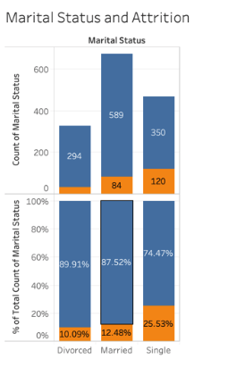
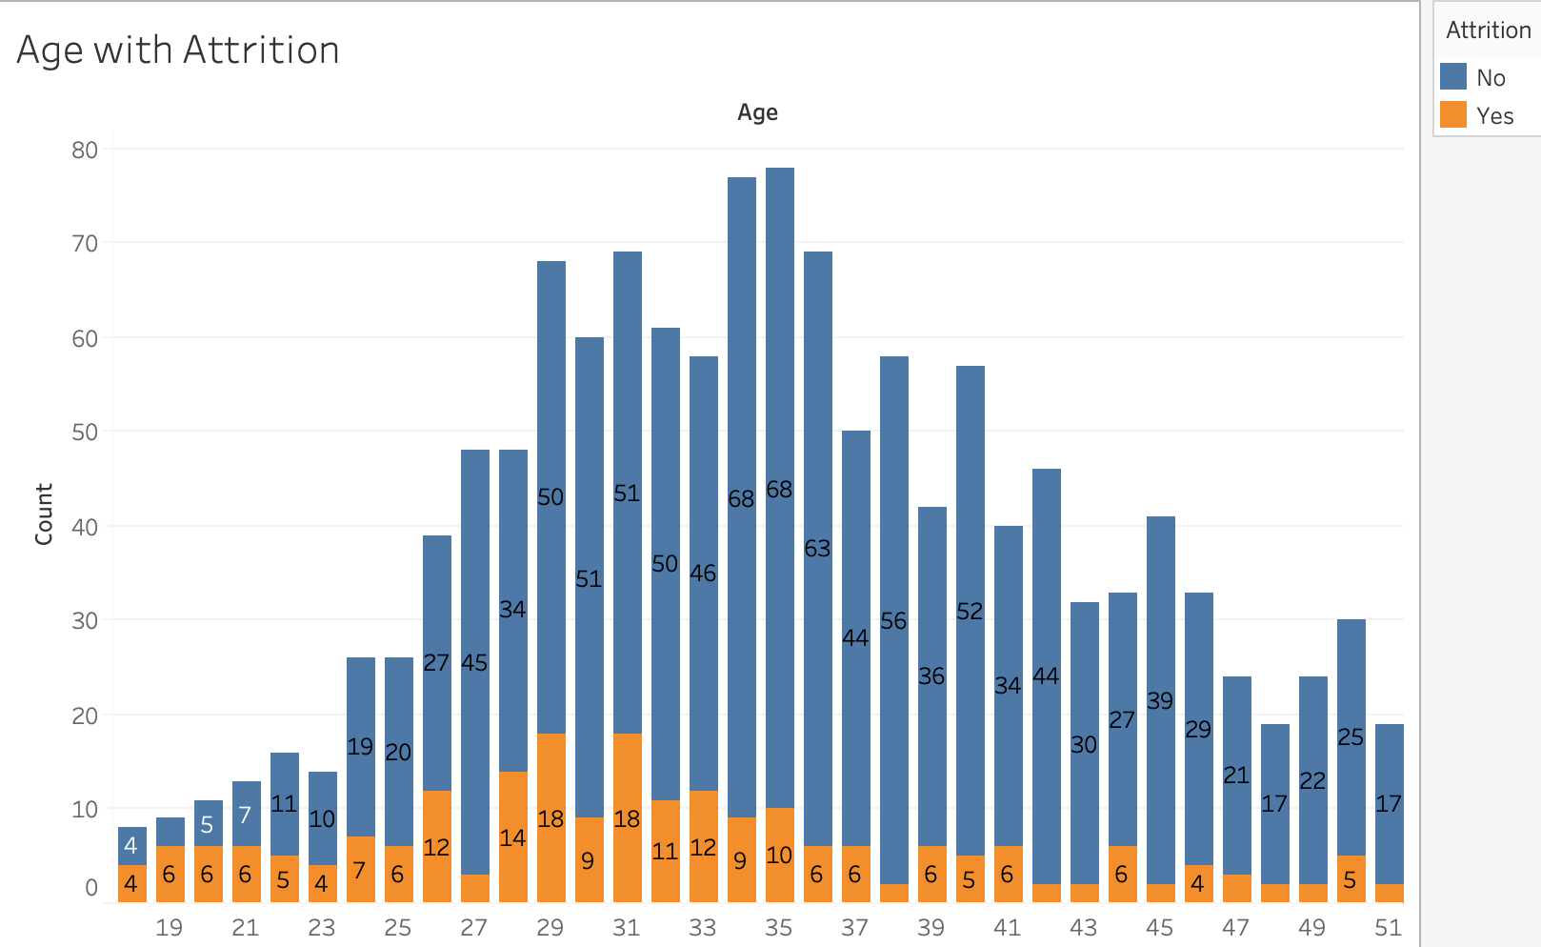
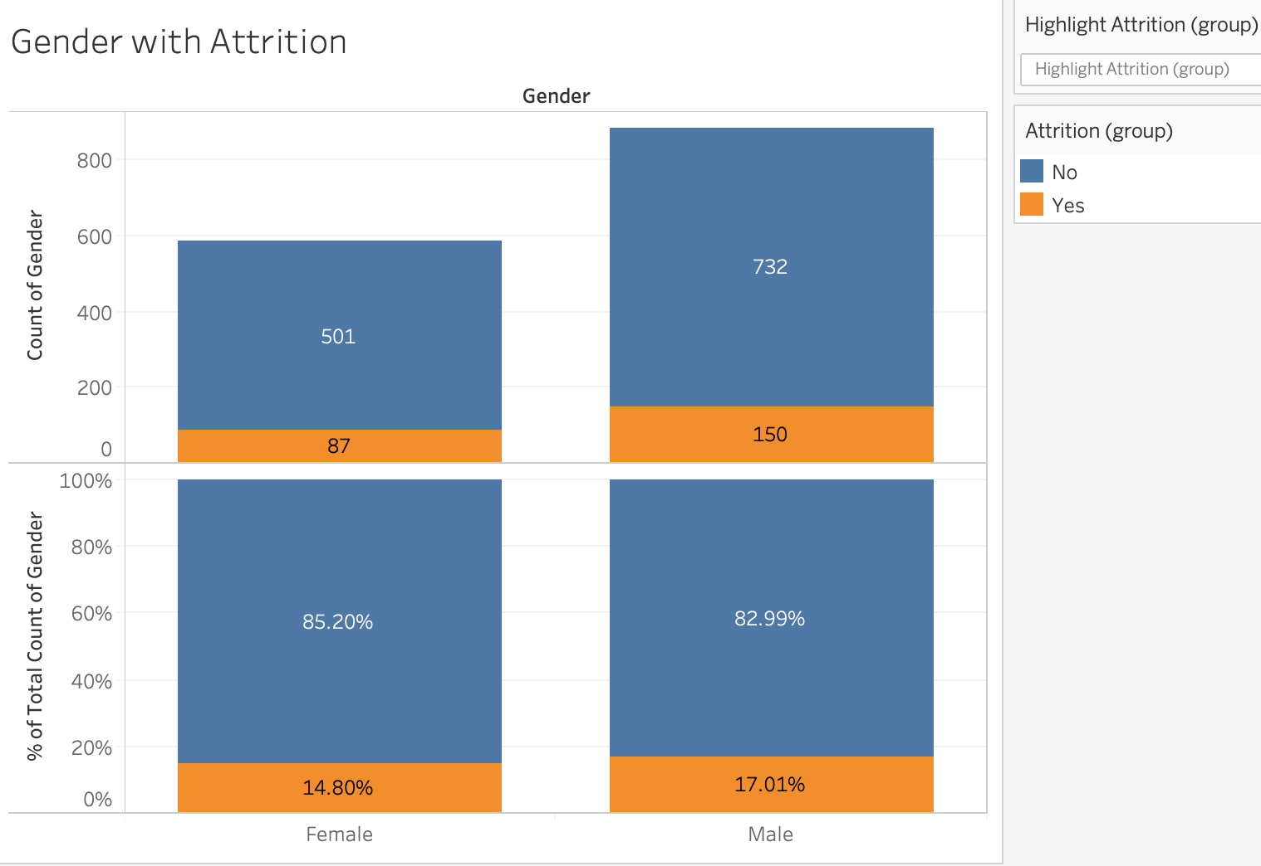
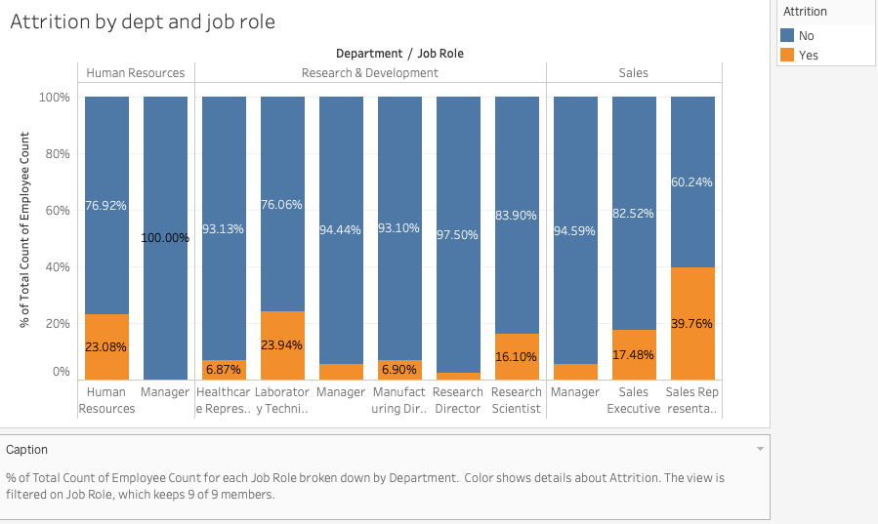
Exploratory Data Analysis of the dataset
The overall attrition rate is 16%.
Demographic and Individual Employee attributes :
Attrition by Age: Younger employees have higher attrition rates
Attrition by Marital status: Attrition rate for Single employees is almost two times the attrition rate of married and divorced
Attrition by Gender: Male has higher attrition rate than female by almost 2%.
Department and Job Role: Employees who are Lab technicians, Sales Executives and Sales reps have high attrition due to lower salaries

Slide 7
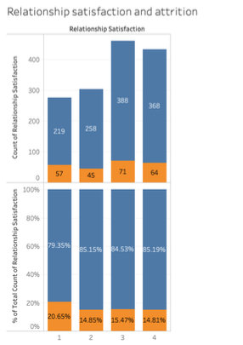
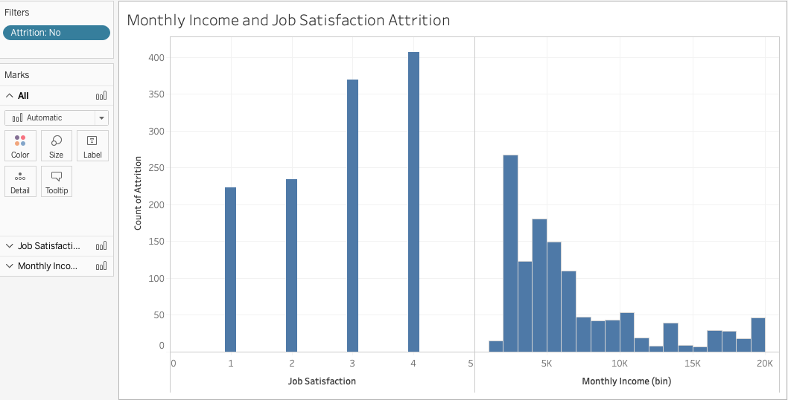
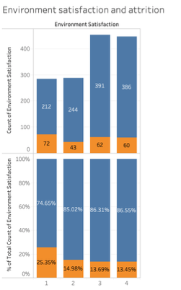
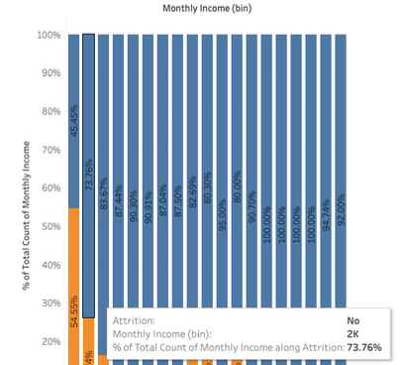
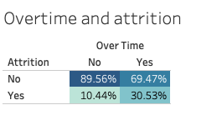
Exploratory Data Analysis of the dataset cont.…
Employee performance and financial attributes
Job involvement, Environment satisfaction and Relationship satisfaction: Attrition rate is lower for employees who are more involved in their job, like the culture and have relationships at work.
Monthly income: Monthly Income plays a major role in attrition and is high for employees who earn < $3K
Overtime: Attrition rate is 20% higher for employees who work overtime as compared to those with no overtime
Monthly Income and Job Satisfaction: The analysis shows that job satisfaction is higher if compensation increases.

Slide 8
Predicting Attrition at the organization
Logistic regression (Log R) model used for linear classification and predicting Attrition.
Key Steps to train the model
Transform category variables into dummy variables
Resolve multicollinearity in the dataset by dropping “Job Level”, “Total Working Years", “Years at company”, “Age”, “Department”, “Years with current manager”, “Years in Current Role” features
80:20 split into training and test datasets
Preserve 16%:84% proportion of “attrition”/”no attrition” observations in test and training datasets
Optimize the C hyperparameter for the Log R model to create the best fitting model for our dataset.
Finally, I optimize the probability threshold to optimize the F1 accuracy of the model
Optimal C for the dataset = 0.42
Baseline scores at a threshold value of 0.5
Scores at the optimal threshold of 0.3
F1 Score = 40%
246 | 1
35 | 12
Recall = 12/(12+35) = 25.5%
Precision = 12/(12+1) = 92.3%
F1 Score = 52.5%
235 | 12
26 | 21
Recall = 12/(12+35) = 44.7%
Precision = 12/(12+1) = 63.6%

Slide 9
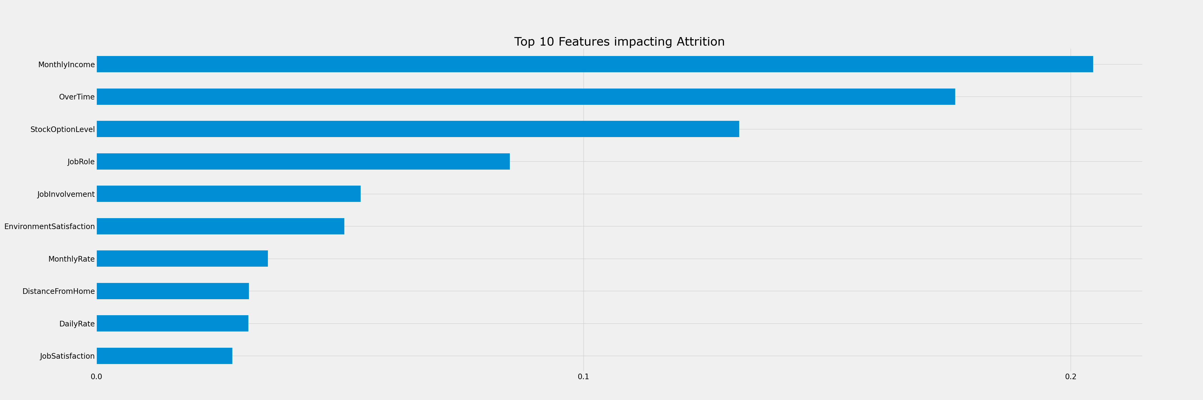
Prescriptive analytics to minimize attrition
Random forest classifier was used to identify the most important attributes impacting attrition at the organization.
Monetary attributes such as Overtime, Monthly Income, Stock option and Daily rate matter to employees. HR managers should focus on improving renumeration policies at the organization.
Job Role, Job Involvement and Environment satisfaction are the second most important factors for attrition. The organization should focus on improving employee engagement to reduce attrition.
The other feature that is important is the distance from home and this should be kept in mind while hiring new personnel at the organization.

Slide 10
Conclusion
Opportunities to improve Attrition prediction
Feature engineering can be utilized for better fitting of the model with greater accuracy in predicting Attrition.
The dataset has a class imbalance problem The model performance can be improved by applying Imbalance Class mitigation techniques such as SMOTE sampling, Cost-sensitive learning and Anomaly detection (Devin Soni, 2018).
A larger dataset will help improve the training of the model thereby improving its performance
Conclusion
This term paper shows the importance of HR analytics and how it can used to bring down hiring costs at an organization through digital transformation.
The term paper also provides insights that can help HR rake decisive steps towards improving organization processes so that employee performance attrition can be lowered in the future.

Slide 11
Reference
Al-Habil, W. I., Allah, A., & Shehadah, M. (2017, November 28). Factors Affecting the Employees' Turnover at the Ministry of High Education in Gaza Governorates-Case study: North and West Gaza Directorates of Education. Retrieved from https://www.omicsonline.org/open-access/factors-affecting-the-employees-turnover-at-the-ministry-of-high-education-in-gaza-governoratescase-study-north-and-west-gaza-dire-2151-6200-1000304-95871.html
Confusion Matrix in Machine Learning. (2020, February 23). Retrieved from https://www.geeksforgeeks.org/confusion-matrix-machine-learning/
Chamberlain, A. (2018, February 28). Why Do Employees Stay? A Clear Career Path and Good Pay, for Starters. Retrieved from https://hbr.org/2017/03/why-do-employees-stay-a-clear-career-path-and-good-pay-for-starters
Galarnyk, M. (2020, February 13). Logistic Regression using Python (scikit-learn). Retrieved from https://towardsdatascience.com/logistic-regression-using-python-sklearn-numpy-mnist-handwriting-recognition-matplotlib-a6b31e2b166a
Habil, W. I. A., Allah, A., & Shehadah, M. (2017). Factors Affecting the Employees’ Turnover at the Ministry of High Education in Gaza Governorates-Case study: North and West Gaza Directorates of Education. Arts and Social Sciences Journal, 08(05). doi: 10.4172/2151-6200.1000304
Mamun, C. A. A., & Hasan, M. N. (2017). Factors affecting employee turnover and sound retention strategies in business organization: a conceptual view. Problems and Perspectives in Management, 15(1), 63–71. doi: 10.21511/ppm.15(1).2017.06

Slide 12
Reference
Mishra, S. (n.d.). REVIEW OF LITERATURE ON FACTORS INFLUENCING ATTRITION AND RETENTION. Retrieved from https://www.academia.edu/39006530/REVIEW_OF_LITERATURE_ON_FACTORS_INFLUENCING_ATTRITION_AND_RETENTION
Chauhan, N. S. (2019, April 4). Real world implementation of Logistic Regression. Retrieved from https://towardsdatascience.com/real-world-implementation-of-logistic-regression-5136cefb8125
Rogers, M. (2020, January 20). A Better Way to Develop and Retain Top Talent. Retrieved from https://hbr.org/2020/01/a-better-way-to-develop-and-retain-top-talent
Seppälä, E., & Cameron, K. (2017, May 8). Proof That Positive Work Cultures Are More Productive. Retrieved from https://hbr.org/2015/12/proof-that-positive-work-cultures-are-more-productive
Using Seaborn Python Package for Creating Heatmap. (2020, March 3). Retrieved from https://blog.quantinsti.com/creating-heatmap-using-python-seaborn/

Slide 13
Reference
Soni, D. (2019, July 16). Dealing with Imbalanced Classes in Machine Learning. Retrieved from https://towardsdatascience.com/dealing-with-imbalanced-classes-in-machine-learning-d43d6fa19d2

